Slide 1
Ch11.4 Part 2 Hypothesis Testing for Two Tailed Scenarios

Slide 2
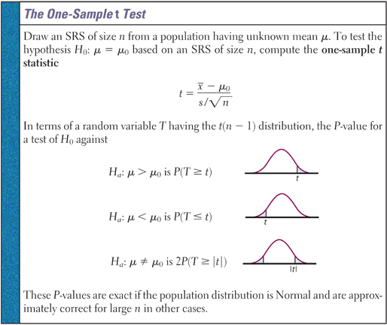
When Do We Have Two Tailed Scenarios
A two tailed scenario is used whenever the alternative hypothesis is not equal to a assumed pop. mean:

Slide 3
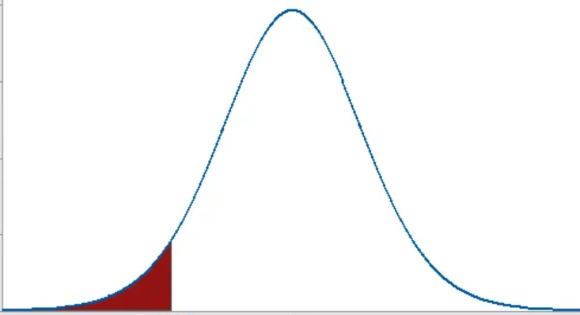
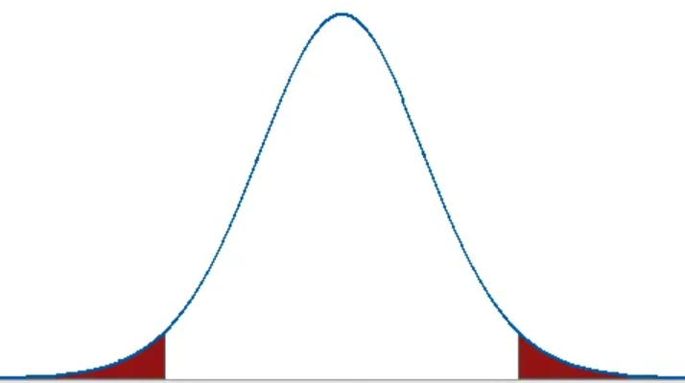
Ex: Find the P-value for each of the following:
a) One Tail b) Two Tail
a) One Tail b) Two Tail

Slide 4
Given each Pvalue, find the critical value:
i) Two Tailed P-value=0.0024, Z=?
A two tail Pvalue of 0.0024 means that each tail is 0.0012
ii) Two Tailed P-value=0.012, df=99, t=?
A two tail Pvalue of 0.012 means that each tail is 0.06

Slide 5
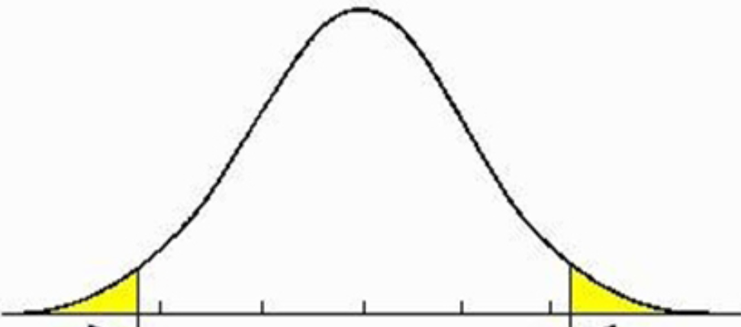
Ex: A SFU professor of a large statistics class uses sampling to decide if grades are to be curved. Curving occurs if the population mean of the grading distribution is not equal to 73%. A random sample of 256 grades has a mean of 68% with SD of 18. Set up a significance level of 1% and interpret the results:
First step, indicate all the statistics and parameters given:
Now find the P-value, not that since its two tailed, we need to get the area of both tails:
Now state the null & alternative hypothesis:
This is a two tailed scenario b/c the scores could be scaled either way: Up or Down
Now find the T-critical value: (pop. SD not given)
Since the P-value is less than any reasonable significance level, we reject Ho and accept the alternative that the average grade is not 73%.

Slide 6
Ex: Chlortalidone, also known as chlorthalidone, is a diuretic medication used to treat high blood pressure. A pharmaceutical company manufactures high blood pressure medication at 25mg of chlortalidone per pill. A random sample of 30 pills gave a mean of 24.2mg of (Chl) with a SD of 2.5mg.
Is there evidence that the company is manufacturing pills not to standard?
Conduct a significance test at α=0.05 b) What is a Type I and Type II error? What are the consequences of each? c) If the pills are actually manufactured with a mean of 24.0mg, what is the probability of a Type II error?

Slide 7

a) State the Null and Alternative Hypothesis:
Note: This will be a two-tailed hypothesis test
Find the test statistic:
Indicate the statistics and parameters given:
Since the pop. Sd is not given, we will be conducting a one-sample t-test:
Now find the P-value:
Verify and check the conditions required:
SRS: it’s indicated that the pills were taken from a SRS
Normality: Since the sample size is 30, the CLT confirms that approximate normality of the sampling distribution of $\overline{x}$
Independence: although all the pills are from the same manufacturing company, we must be willing to assume the amount of drug in each pill is independent of each other.
Since the P-value is greater than our desired significance level of 0.05, we would fail to reject Ho and accept that the pills are manufactured within standard levels of Chlortalidone

Slide 8
b) A type I error is where we reject Ho when it is true. For example, we conclude that the pills are not to standard when they actually have the correct mean of medical content. A consequence is that resources will be wasted to correct a problem that doesn’t exist.
A type II error is where we fail to reject Ho when it is false. An example is where the medical content is less than desired but we assume that it is up to standard. A consequence is that people that are using the medicine may not get enough/or too many of the drug content. This could lead to health complications and maybe even to lives being lost.

Slide 9
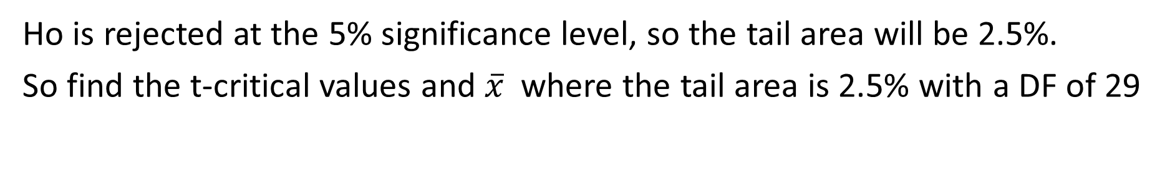
C) Assume that this is the sampling distribution with Ho being true:
Ho is rejected at the 5% significance level, so the tail area will be 2.5%.
So find the t-critical values and $\overline{x}$where the tail area is 2.5% with a DF of 29
Now suppose this is the sampling distribution with the actual pop.mean of (24.0mg)
This purpose region is the probability of failing to reject Ho when it’s false
This red region is the POWER, the probability of rejecting Ho when it is false

Slide 10
Q: From the previous question, which of the following input on a Ti-83 will give the correct probability of a Type II error?
“E” technically isn’t correct b/c it didn’t subtract the tail on the right, even though the value is very small.
Answer: both “A” and “C” both work.
“A” works b/c the t-distribution with a df 0f 29 is similar to a z-distribution.
“C” work because you need to find the new “t*” values using μ=24mg with the two sample means.
Between “a” and “C”, answer “C” is the better answer!

